Slide 1
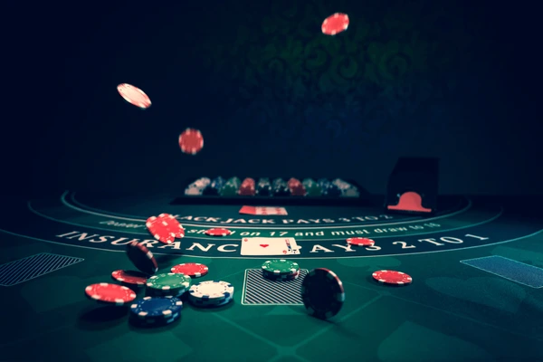
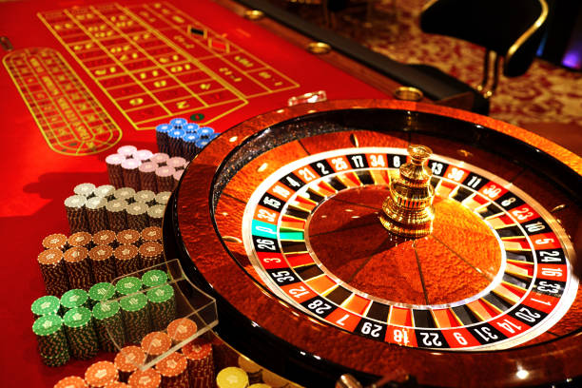
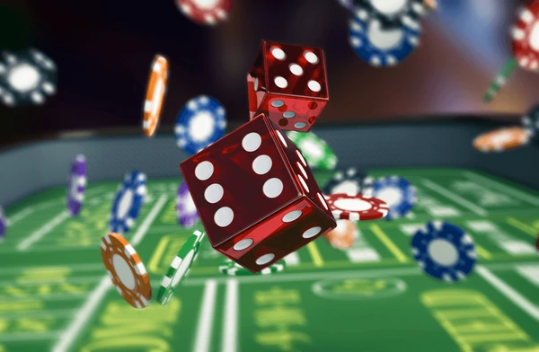
Welcome to the Gaines Casino!
Easy to Code Games in C++
Simple Win/Lose condition
Fun Gameplay
Games:
Blackjack
Craps
Slot Machine

